Slide 1
MENTAL HEALTH IN TECH INDUSTRY
An Exploratory Data Analysis
Aboli Moroney
M.S Data Science at University of Washington, Seattle
Research Project for DATA 512A Human Centered Data Science Course
Research Timeline: 03 Nov 2020 - 08 Dec 2020
Visit GitHub Repository

Slide 2

Motivation
Personal 2020 Goal: Mental Health & Emotional Wellbeing Awareness
Work life in tech is increasingly stressful and competitive
Stigma associated is often exacerbated in tech where your “brain” is considered your greatest asset ^{[1]}
51% of people in tech diagnosed with mental health disorders according to OSMI ^{[2]}
CDC estimates that depression causes 200 million lost workdays each year at a cost to employers ranging from $17 to $44 billion dollars (USD) ^{[3]}
Pressing need to spread awareness, share experiences and drive change in our community
References cited in speaker notes below
LET’S TALK BEFORE IT’S TOO LATE
Image designed by rawpixel.com / Freepik
Notes:
References:
[1] Let's Talk: It's Time to Get Serious About Mental Illness in Tech
[2] OSMI Mental Health in Tech Survey 2016
[3] Mental Health Care Makes Good Business Sense by Beth Tucker Long

Slide 3

Research
Questions
What are the provisions at tech workplaces to address mental health issues in employees?
Data Source
OSMI 2019 Mental Health in Tech Survey ^{[1]}
352 respondents
82 survey questions
1. SUPPORT IN TECH
Do employees feel that the tech industry supports mental health and wellbeing?
5. LEAVE POLICY
2. EXPERIENCING ISSUES
Are the leave policies favourable to those undergoing mental health issues?
How many respondents have experienced mental health problems or are currently being diagnosed?
4. MENTAL VS. PHYSICAL HEALTH
3. HEALTHCARE & HELP
Do employers give the same amount of importance to mental health and physical health issues?
What are healthcare benefits, awareness initiatives and help resources available to employees at workplaces?
Image designed by Freepik
Notes:
References:
[1] OSMI Mental Health in Tech Survey 2019

Slide 4
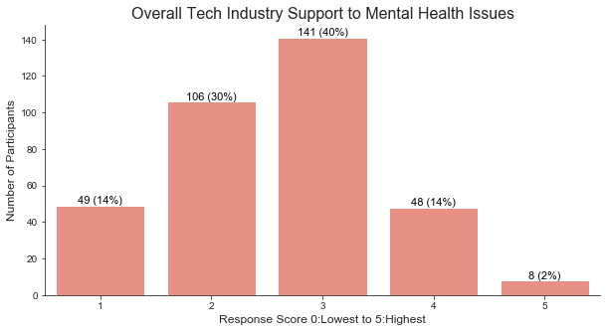
Support for Mental Health in Tech
84% of the participants have responded with a score between 1 to 3 to indicate inadequate support
40% participants have voted for score 3 indicating moderate support
Only 16% of the participants have responded with a score between 4 and 5 to indicate good support
Implications
Overall perception of support for mental health in tech is not adequate

Slide 5
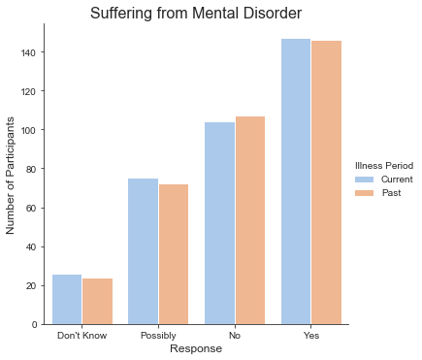
Mental Health Issues Experienced
~42% respondents (~147 / 352) have experienced a mental disorder in the past/at present
~30% participants (~107 / 352) have never experienced any mental illness
~29% participants (~100 / 352) are unsure if they have ever suffered from a mental disorder
Implications
More participation from employees who have faced a mental health issue/unsure could lead to bias in data
Only 30% respondents confidently claim no mental health issues - alarmingly high number of affected employees

Slide 6
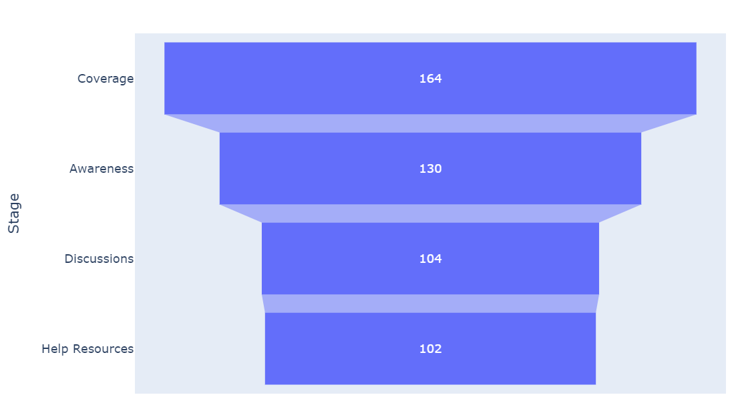
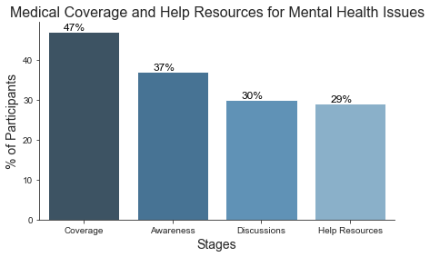
Medical Healthcare & Help Resources
Decreasing respondents at stages coverage (47%), awareness (37%), discussions (30%) and help resources (29%)
Less than 50% of the participants have healthcare coverage for mental health issues and merely 30% end up getting additional help and resources
Implications
Healthcare options, forums for discussions and resources to seek help are not adequate in the tech workplaces
Mental health benefits are part of healthcare plan
Employee knows options under health coverage
Formal discussions, wellness campaigns
Resources to learn more and seek help

Slide 7
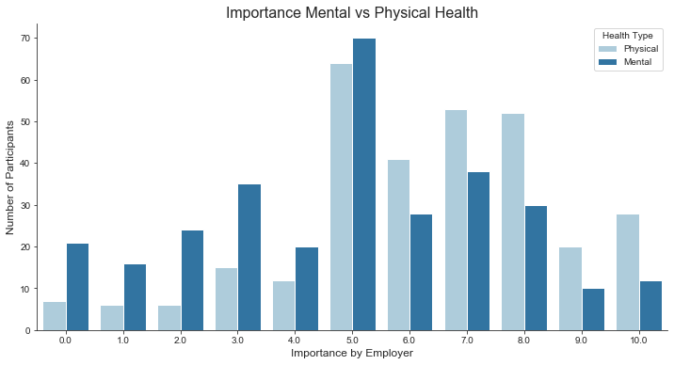
Importance for Physical & Mental Health
Importance given by employers to physical health has higher distribution between scores 5 to 10 with the peak at 5
Importance given by employers to mental health has higher distribution between scores 3 to 7 with the peak at 5
Implications
Employers do not give enough importance to mental health compared to physical health

Slide 8
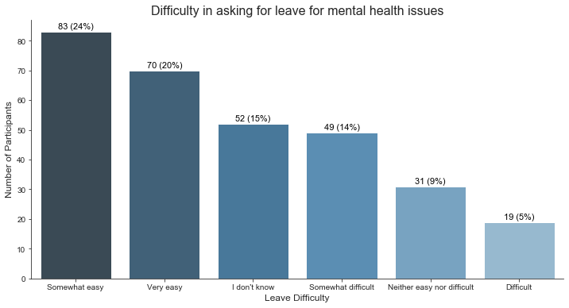
Leave Policy for Mental Health Issues
44% respondents find it relatively easy to ask for leaves for mental health while 19% respondents find it relatively difficult
30% respondents are neutral/unaware of the difficulty they may pose while asking for time off.
Implications
Leave policies around mental health issues may be in favor of the employees at many workplaces but employers may want to take more effort to improve and create awareness among employees

Slide 9
Conclusion
84% - inadequate support to mental health in tech
70% - may have experienced mental disorders
53% - don’t have medical coverage for mental issues
70% - don’t have forums to discuss and seek help
Majority - Physical Health importance >> Mental Health
56% - don’t feel comfortable asking for leaves
Limitations
Findings should be generalized with caution as the survey respondents may not be a fair representation of the entire population in the tech industry and workplaces
The way forward…
Discussions to overcome stigma
Inclusive healthcare plans to cover mental health
Awareness of issues and help resources
Leave policies for mental wellbeing
Sustainable work environment
Timely surveys to assess the situation
LET’S TALK BEFORE IT’S TOO LATE
Image designed by rawpixel.com / Freepik

Slide 10
Thank you!
Feedback / Questions?
Image designed by Freepik

